Slide 1
Marriage Hall Booking Application
Presented by – Pranjal Srivastava
Rishabh Varshney
Shabdansh yadav
Shardindu
Saksham Mishra

Slide 2
Case Study Problem Statement
Marriage Hall booking Application is to provide venue details to customers, with various modules Admin, Supervisor, Vendors and Customer .
This application provides Hall details like seating capacity,
No of rooms available etc. Provides online and offline booking system

Slide 3
Actors
Admin: Add/Edit/Delete/View vendor and supervisor details.
Supervisor : Can provide hall details like Venue details , Electrical equipment details, Dining details, housekeeping details, pricing and billing etc
Vendor : Can provided various facility with costing like catering, flower decors, music systems, Video coverage etc.
Customer : Can have a preference to search for Hall with preferences city , Location, Date and Timing property

Slide 4
Services
Admin Vendor Service to add, delete, update and list available vendors
AdminsupervisorService to add, delete , update and list available supervisors/managers
Booking service : This service is to the customer for booking the hall with his preferences
Supervisor Service can provides with all services with details like Venue details , Electrical equipment details, Dining details, housekeeping details, pricing and billing etc
Vendorservice : This service can provide various facility with costing like catering, flower decors, music systems, Video coverage etc.
Customer : Can have a preference to search for Hall with preferences city,Location, Date and Timing

Slide 5
Technology Used
Java 8
Postgres

Slide 6
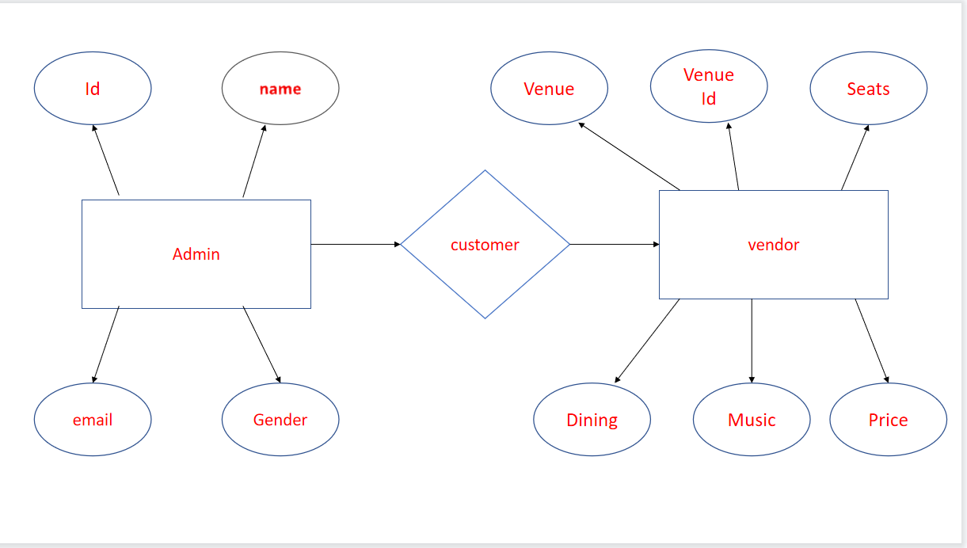
ER Diagram

Slide 7
THANK YOU

